Slide 1
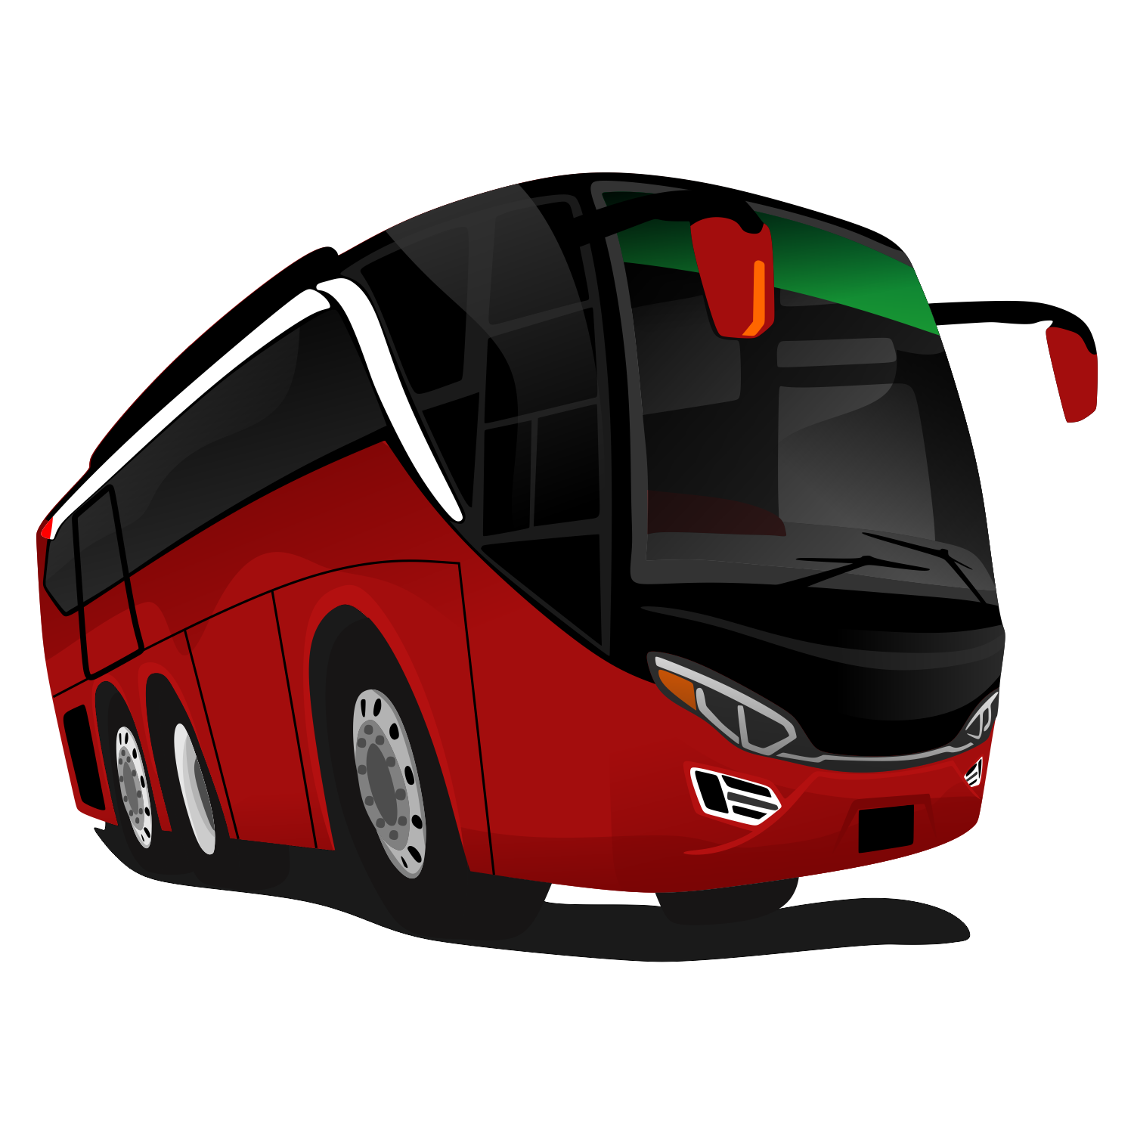
Wonder Wheels
ONLINE BUS BOOKING SYSTEM
GROUP- 10

Slide 2
S.NO | NAMES
1 | Syed Mohammed Akram
2 | Thotakuri Malavika
3 | U Santhosh
4 | Varshini X
5 | Vishnukumar Balasubramani
6 | Yanamaladoddi Lekhya
7 | Yendamuri Gokulesh
TEAM MEMBERS

Slide 3

INTRODUCTION
The foundation of our bus booking system rests on Java Spring Boot, MySQL, and Angular, boasting robust role-based authorization and authentication for both administrators and users, ensuring secure and efficient access to our platform.
Step into the world of hassle-free travel arrangements with Wonder Wheels' cutting-edge Online Bus Booking System, empowering users to explore routes, make reservations, and finalize payments with ease.

Slide 4
SCOPE
The online bus booking system covers:
Users should have the ability to log in to the system directly from the application's initial page.
Alternatively, users can register for access to the system.
Users should have the capability to create a new login in order to access the reservation facility..
Users should be able to search for and book a specific bus.

Slide 5
TECHNOLOGIES USED IN BACKEND
Spring Boot
Maven
Spring Data JPA
JDK
MySQL Database
Hibernate

Slide 6
DEPENDENCIES
Spring-Boot Dev Tools
My SQL-Connector
Spring Starter Security
Spring-Boot Data JPA
Spring-Web

Slide 7
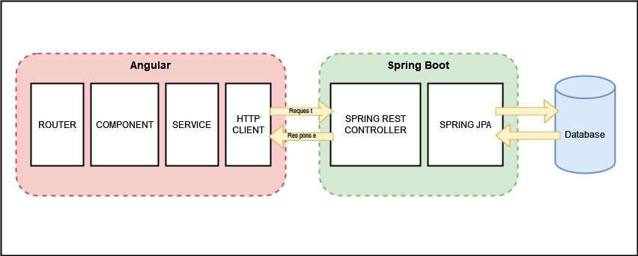
WEB APPLICATION BLOCK DIAGRAM

Slide 8
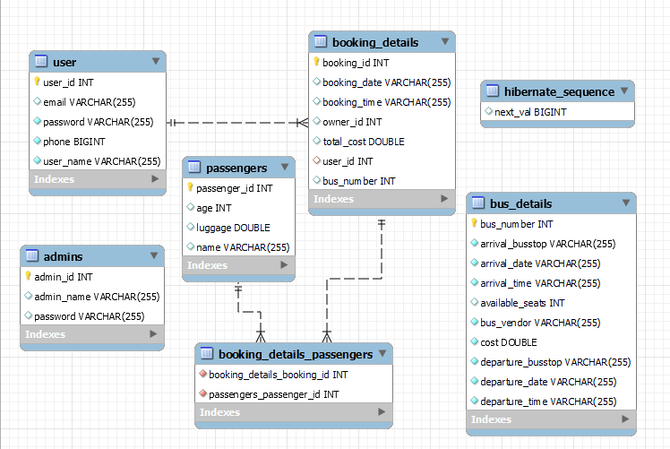
ER DIAGRAM

Slide 9
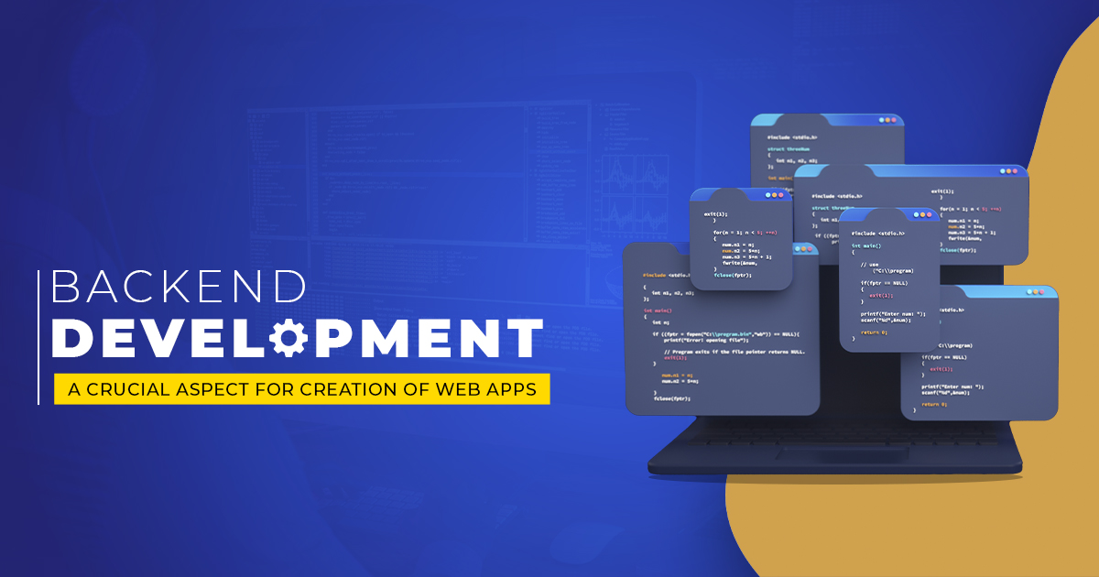
MODULES IN BACKEND
Entity
Controller
DAO
Service
Service Implementation (ServiceImpl)
Exceptions
Security
Util

Slide 10
ENTITY MODULE
Entity module defines the basic entities required for this application that are stored in the database. Each entity is represented in the form of tables in the Database.
Those entities are
Admin: Defines the Admin entity with 3 properties which are Admin ID, Admin Name and Password.
Booking Details: Defines the entity with following properties. Booking ID, Booking Date, Booking Time, Total Cost, Bus Number and User ID.
Bus Details: It has following properties. Bus number, Departure stop, Arrival stop, Available seats, Departure date, Arrival date, Arrival time, Departure time, Bus vendor and Cost.
Passenger: It is defined with following properties Passenger ID, Name, Age and Luggage.
User: It has following properties such as User ID, User Name, Password, Email and Phone. User entity is related with Booking details entity in one to many relationship.

Slide 11
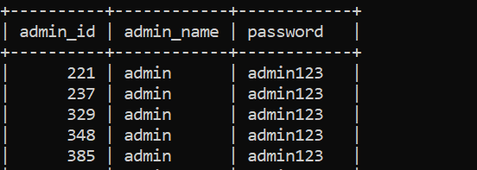
ADMIN ENTITY CLASS
This Defines the Admin entity with 3 properties which are Admin ID, Admin Name and Password.
Admin ID - Primary key
Admin Name - Column
Password - Column

Slide 12
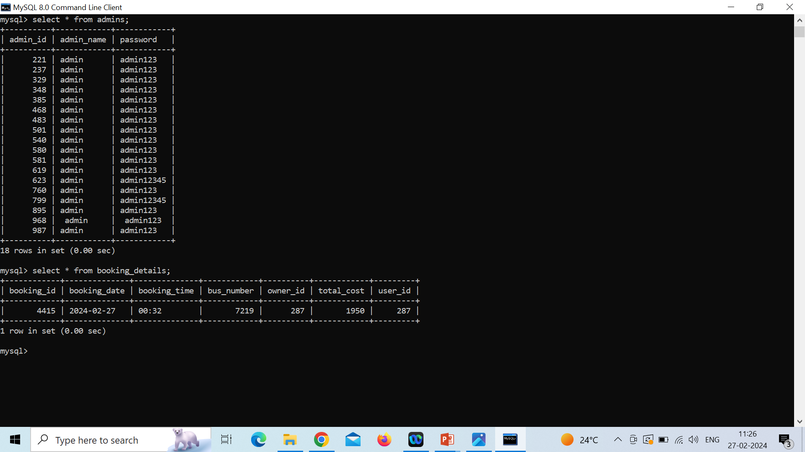
BOOKING DETAILS ENTITY CLASS
Defines the entity with following properties. Booking ID, Booking Date, Booking Time, Total Cost, Bus Number and User ID.

Slide 13
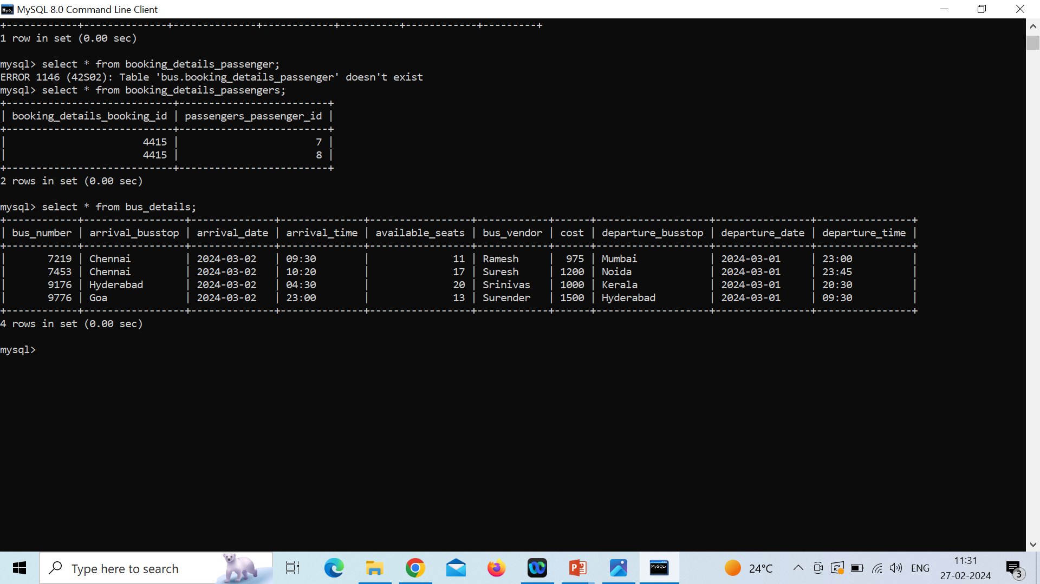
BUS DETAILS ENTITY CLASS
It has following properties. Bus number, Arrival_bustop, Arrival_date, arrival_time, available_seats, bus_vendor, cost, departure_busstop, departure_date, departure_time.

Slide 14
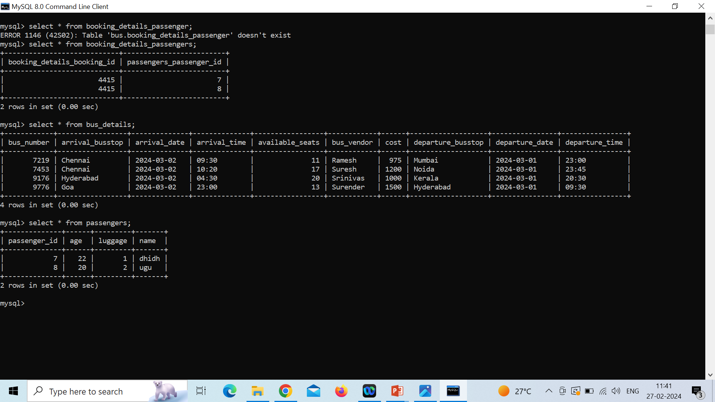
PASSENGER ENTITY CLASS
It is defined with following properties Passenger ID, Name, Age and Luggage.

Slide 15
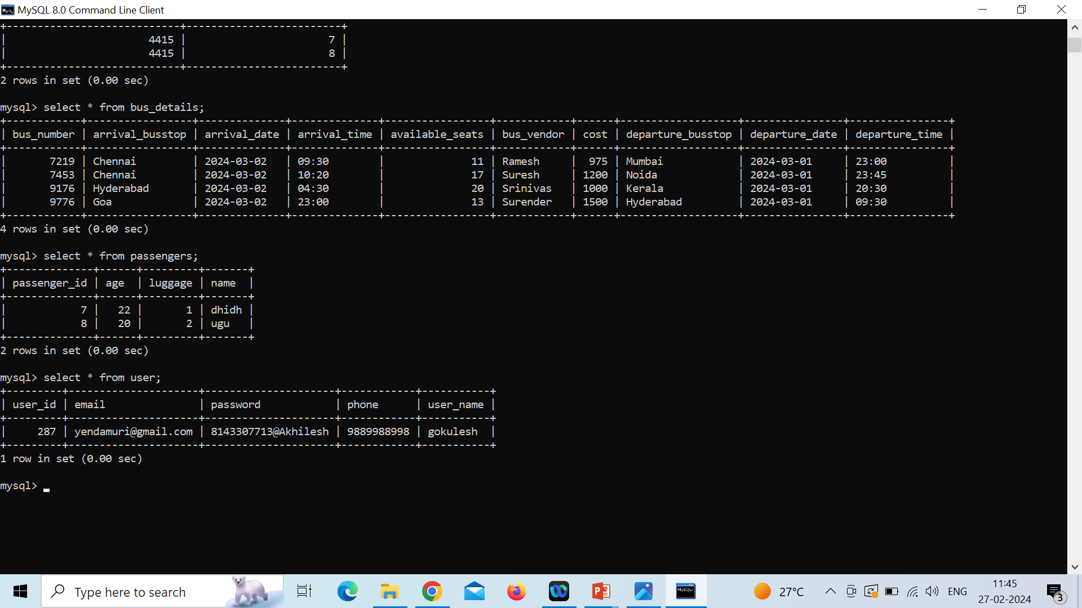
USER ENTITY CLASS
It has following properties such as User ID, User Name, Password, Email and Phone. User entity is related with Booking details entity in one to many relationship.

Slide 16
CONTROLLER MODULE
Controller module provides the HTTP request and response mappings for the entities in the application between the application and the Database.
This application has two Controller components.
Admin Controller: This controller provides the HTTP request and response mappings for the Admin entity and the functionalities of that entity such as Admin login, Add admin, Delete admin, Add bus details, Update bus details and etc.
User Controller: User controller provides the HTTP mappings for user functionalities such as User login, Add user, Update user, Add booking, Delete Booking and etc.

Slide 17
DAO LAYER
Data Access Object (DAO) pattern is a structural pattern that allows to isolate the application/business layer from persistence layer using an abstract API.
It is used to abstract the retrieval of data from a data resource such as a Database.
All the entity classes are extended to JPA repository in order to perform CRUD operations.
This application has DAO classes (or interfaces) for the defined entities, which are
Admin DAO
User DAO
Bus Details DAO
Booking Details DAO
Passenger DAO

Slide 18
SERVICE AND SERVICE IMPLEMENTATION MODULES
Service: The Service module declares the methods that are used by the entities.
Service module declares Admin Service and User Service classes which has many methods that are implemented in serviceImpl module.
Service Implementation (ServiceImpl): This module implements all the methods specified in the Service module classes. It also uses dependency injection technique to implement the Dao modules.
It defines the functions for both Admin Service and User Service classes.
Methods defined by this module are such as Add admin, Delete admin, Admin login, Add bus details, Update bus and etc. for Admin Service class and then User login, Add user, Delete user, Update user, Add booking, Delete booking and etc. for User Service class.

Slide 19
SERVICE & SERVICEIMPL METHODS
User Methods
public User addUser(User user);
public void updateUser(User user);
public User getUser(Integer userId);
public void deleteUser(Integer userId);
public User userLogin(UserAuth auth);
public BookingDetails addBooking(BookingDetails booking, Integer userId, Integer busNumber);
public void deleteBooking(Integer bookingId, Integer userId);
public List<BookingDetails> getBookingByUserId(Integer userId);
public BusDetails findByRouteAndDate(String arrivalBusstop, String departureBusstop, String date);
public BusDetails getBusByBusNumber(Integer busNumber);
public Passenger updatePassenger(Passenger passenger);
Admin Methods
public Admin addAdmin(Admin admin);
public Admin getAdmin(Integer adminId);
public void deleteAdmin(Integer adminId);
public Admin adminLogin(AdminAuth auth);
public List<BusDetails> getAllBusDetails();
public BusDetails addBusDetails(BusDetails details);
public void deleteBus(Integer busNumber);
public BusDetails updateBus(BusDetails details);
public List<Passenger> getAllPassengers();
public List<Passenger> getPassengersByBooking(Integer id);

Slide 20
Custom Exception Classes
AdminAlreadyExistException.java
AdminDoesnotExistException.java
AdminExceptionHandler.java
BookingDoesNotFoundException.java
BusDetailsAlreadyPresentException.java
BusDetailsExceptionHandler.java
BusDetailsNotFoundException.java
ExceptionObject.java
NullAdminException.java
NullBusDetailsException.java
NullUserException.java
PassengerNotFoundException.java
RecordAlreadyPresentException.java
RecordNotFoundException.java
UserAlreadyExistException.java
UserDoesnotExistException.java
UserExceptionHandler.java
UserValidationException.java

Slide 21
Security Considerations
Authentication and Authorization:
Implement robust user authentication to ensure only authorized users can access your application.
Define roles (e.g., admin, user) and restrict access based on these roles.
Input Validation and Sanitization:
Use libraries or frameworks that handle input validation automatically.
HTTPS :
Enable HTTPS to encrypt data transmitted between clients and the server.
Regular Security Audits and Updates:
Keep your application and libraries up to date with security patches.

Slide 22
UTIL MODULE
This module has two classes.
Admin Authorization (AdminAuth)
User Authorization (UserAuth)
Both of these classes are used to set the Authorization values for the 2 entities namely Admin and User.
Admin entity has Admin ID and Password for admin login.
User entity has User ID and Password for user login.

Slide 23
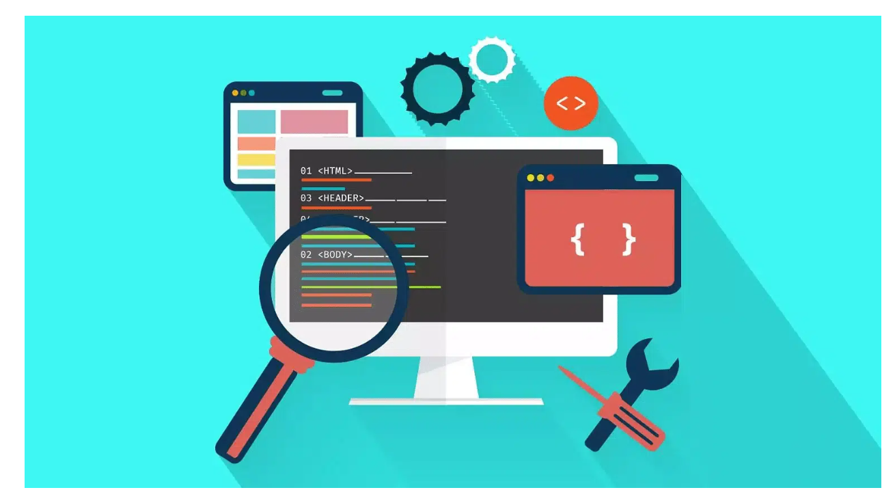
TECHNOLOGIES USED IN FRONTEND
VisualStudio Code IDE
Angular
Node js & Npm
TypeScript
Angular CLI
Bootstrap

Slide 24




ANGULAR
Angular is a framework and platform for building single-page client applications using HTML and Type Script . Angular is written in Type Script.
Great for Single page applications.
Angular is modular.
Built-in features DI, data binding etc.

Slide 25
ANGULAR MODULE
Angular applications are modular and Angular has its own modularity system called Ng Modules. Ng Modules are containers for a cohesive block of code dedicated to an application domain, a workflow, or a closely related set of capabilities They can contain components, service providers, and other code files whose scope is defined by the containing Ng Module. They can import functionality that is exported from other Ng Modules, and export selected functionality for use by other Ng Modules.
Imports in module:
FormsModule
ReactiveFormsModule
HttpClientModule
BrowserModule
AppRoutingModule
Ng Module
Angular applications are modular and Angular has its own modularity system called Ng Modules. Ng Modules are containers for a cohesive block of code dedicated to an application domain, a workflow, or a closely related set of capabilities They can contain components, service providers, and other code files whose scope is defined by the containing Ng Module. They can import functionality that is exported from other Ng Modules, and export selected functionality for use by other Ng Modules.

Slide 26
Angular Routing
The Angular Router is an object that enables navigation from one component to the next component as users perform application tasks like clicking on menus links, buttons or clicking on back/forward button on the browser. We can access the router object and use its methods like navigate() or navigateByUrl(), to navigate to a route.
Router Link
The Router Link is a directive that binds the HTML element to a Route. Clicking on the HTML element, which is bound to a Router Link, will result in navigation to the Route. The Router Link may contain parameters to be passed to the route’s component.

Slide 27
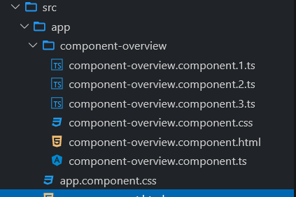
ANGULAR COMPONENTS
Components are the most basic UI building block of an Angular app. An Angular app contains a tree of Angular components. Angular components are a subset of directives, always associated with a template. Unlike other directives, only one component can be instantiated for a given element in a template.
Each component consists of
An HTML template that declares what renders on the page
A TypeScript class that defines behavior
A CSS selector that defines how the component is used in a template
Optionally, CSS styles applied to the template

Slide 28

ANGULAR COMPONENTS IN THE PROJECT
Home:
It is the Landing Page of the application. It has Navigation to Login and Register
Admin-Login:
Admin contains a page for login form and method to validate the Admin Login
User-Login:
User Login contains a page for user login form and a method to validate the user login.
User-Register:
This component contains a page for user registration form and method to store the details in Database.

Slide 29
Admin-Home:
After log-in as Admin, admin can perform two functional operations. Adding new Bus and viewing all the entries. This home page has an option to navigate the admin to perform these functionalities.
Add-Bus-Details:
This component contains a form inside a template page to add new bus details and TS file containing method to store the data entered in form into the database.
View-All-Bus-Details:
This component contains a viewing page which shows all the details and list of all the bus details and functionalities like updating bus details and deleting the existing bus from database.

Slide 30
User-Home:
After Login as User, User has 4 Functionalities Book Tickets for passengers, View Bookings, View User Details, Update User Details. This component contains the option to search the bus for user provided routing details and Route the user to add passenger details. This page also navigate the user to View Booking, View User Details, Update User Details.
Add-Passengers:
After selecting the bus, User needs to submit the passenger details of passengers in the form to store the data in the Database.
Show-User-booking:
This component contains all the bookings made by the logged in user. Can view the passenger and bus details for a specific booking.

Slide 31
Update-Passengers:
This component contains a form to update the passenger details and change it in data base.
View-User-details:
This component displays the user details.
Update-User:
This component contains a form to update the user details.
Error:
This component handles the error
Page-not-found:
This component handles 404 Error.

Slide 32
View All User Component:
This component displays all the users details from the admin side
View All Bookings:
This component displays all bookings of a user using user ID
About us:
This component provides information about the Online Bus Booking System
Contact us:
This component displays the contact details for customer support

Slide 33
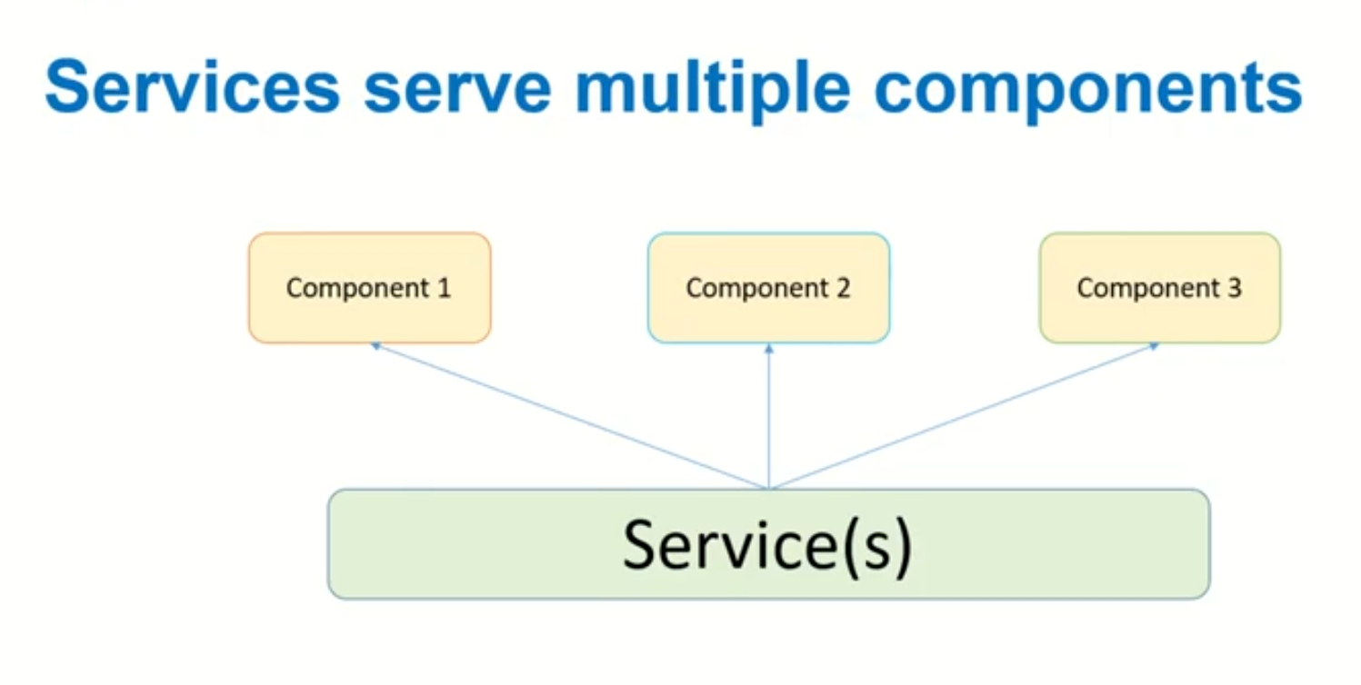
Angular Services
Service is a piece of reusable code with a focused purpose. A code that you will use across multiple components in your application.
Our components need to access the data. You can write data access code in each Component, but this is very inefficient and breaks the rule of single responsibility. The Component should focus on presenting the data to the user.
Command to generate service: ng g s <service_name>
There are two services in this application
Admin-Service
User-Service

Slide 34
Admin Service:
adminLogin()
getAdminDetails()
addBus()
modifybus()
removebus()
viewAllbus()
User-Service:
addUser()
UserLogin()
addBooking()
getBookingbyUser(id)
deleteBooking()
updateUser()
getUser()
getBusbyNumber(busNumber)
addPassenger()
updatePassenger(passenger)

Slide 35
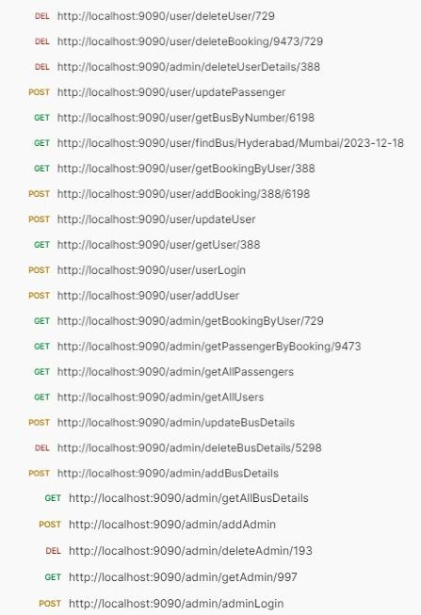
POSTMAN CLIENT FUNCTIONAL TESTING MODULES

Slide 36
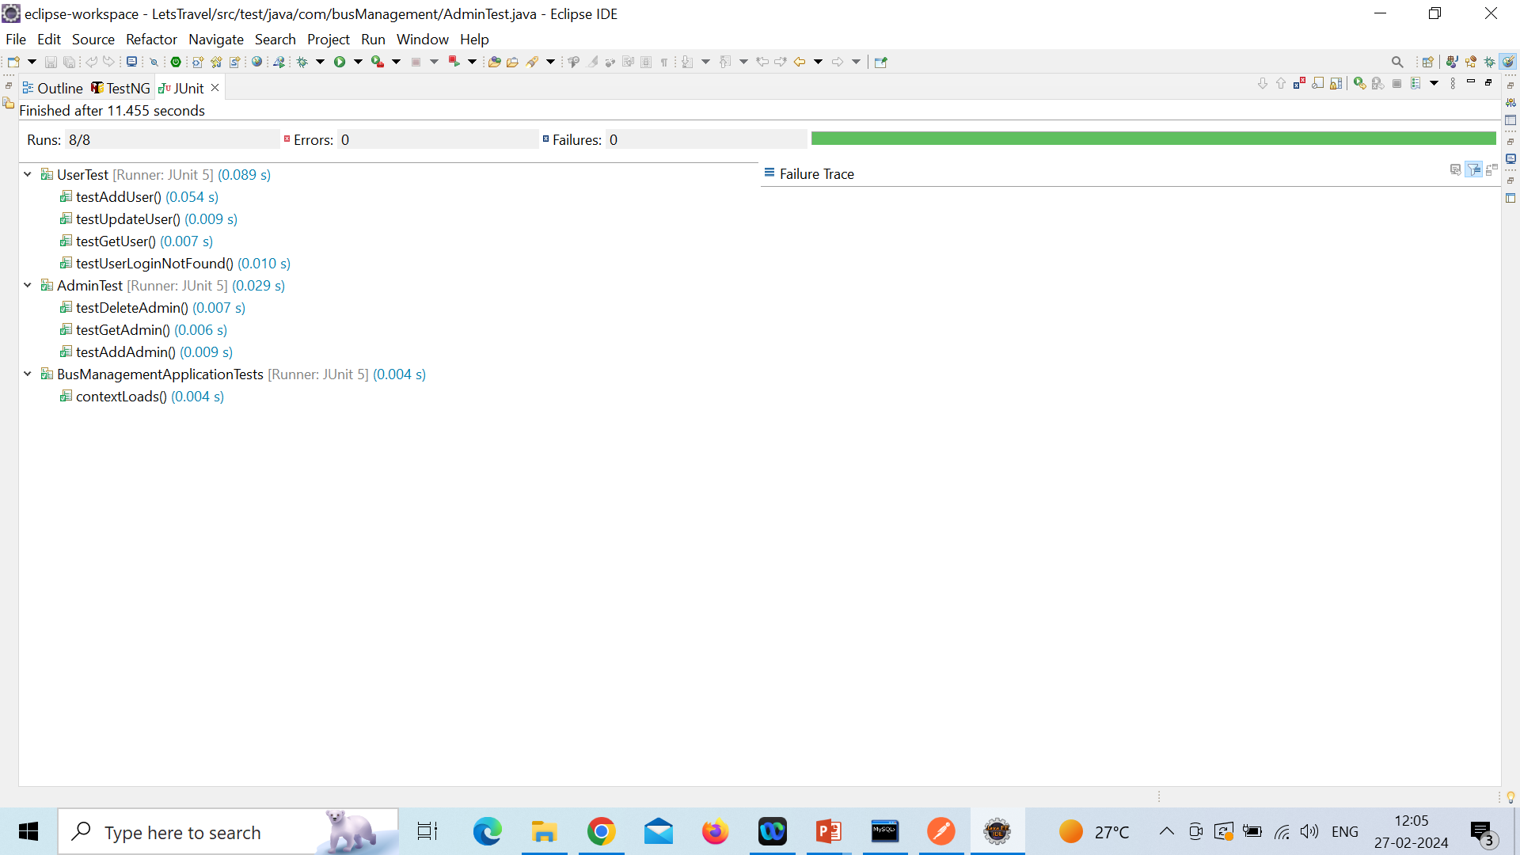
JUNIT TESTS

Slide 37
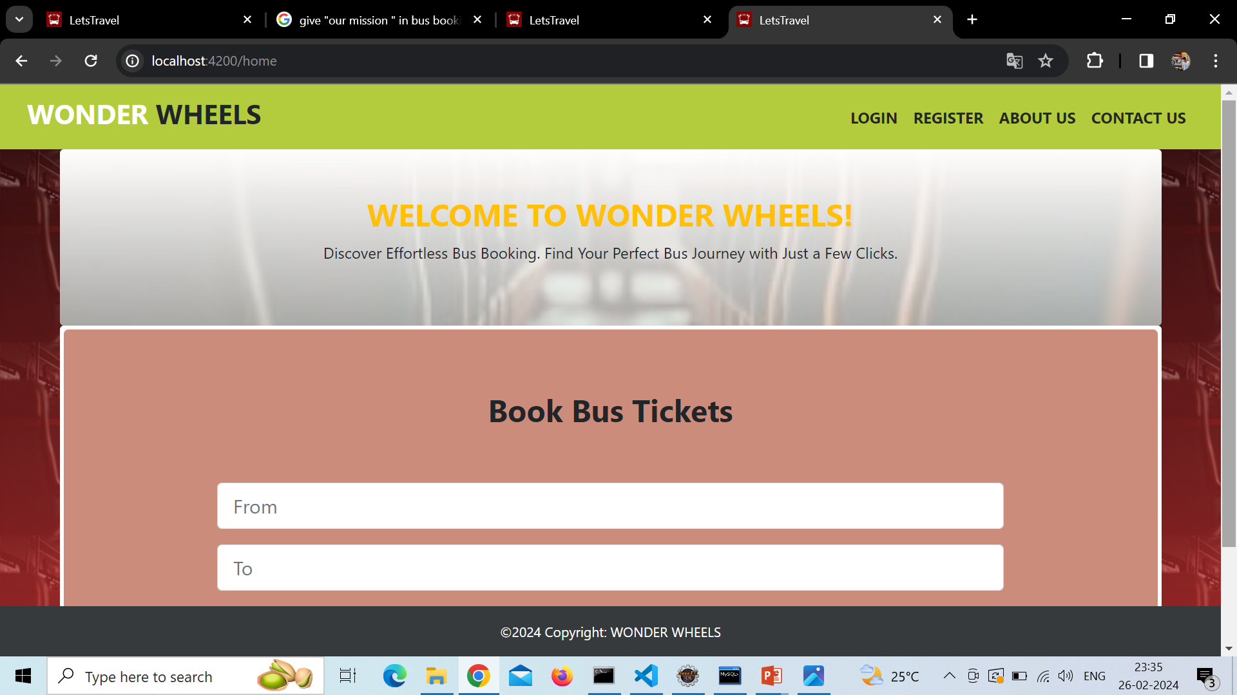
HOME PAGE

Slide 38
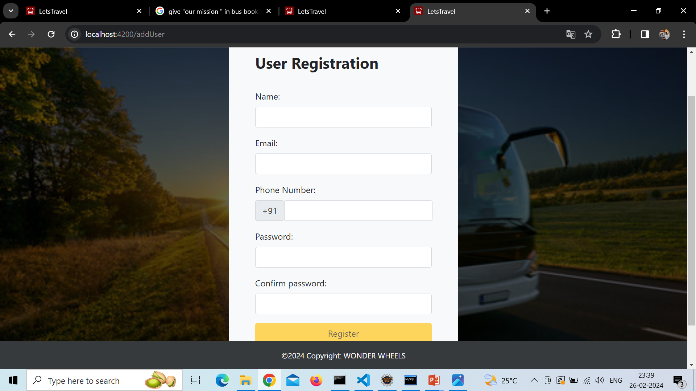
USER REGISTRATION

Slide 39
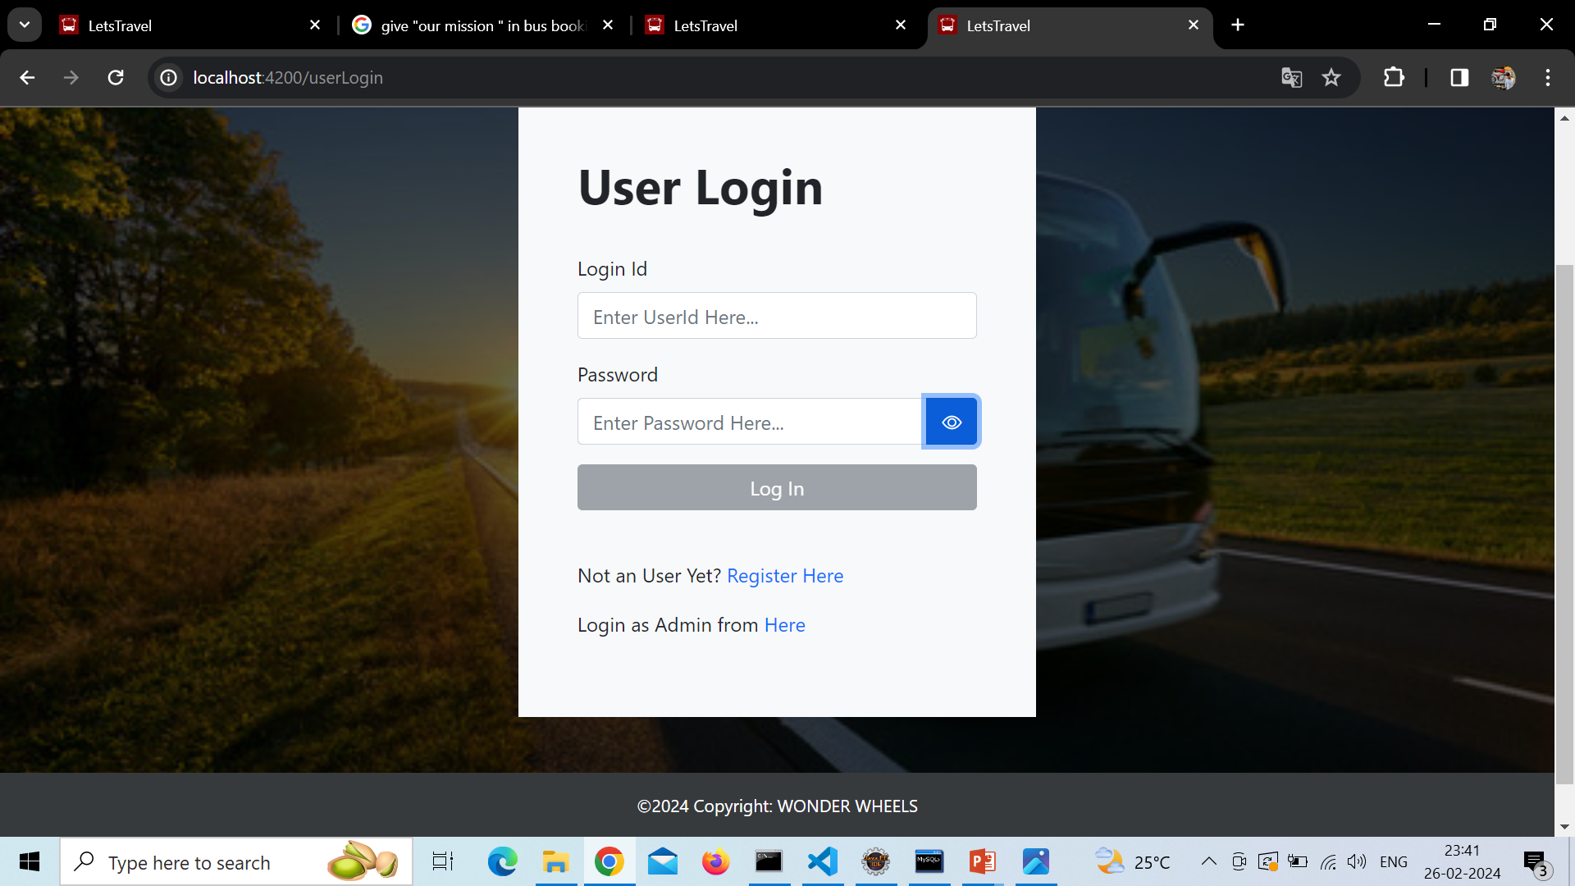
USER LOGIN PAGE

Slide 40
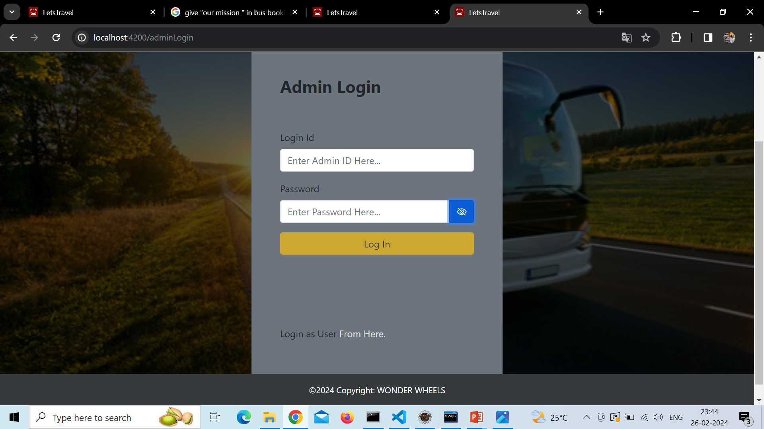
ADMIN LOGIN PAGE

Slide 41
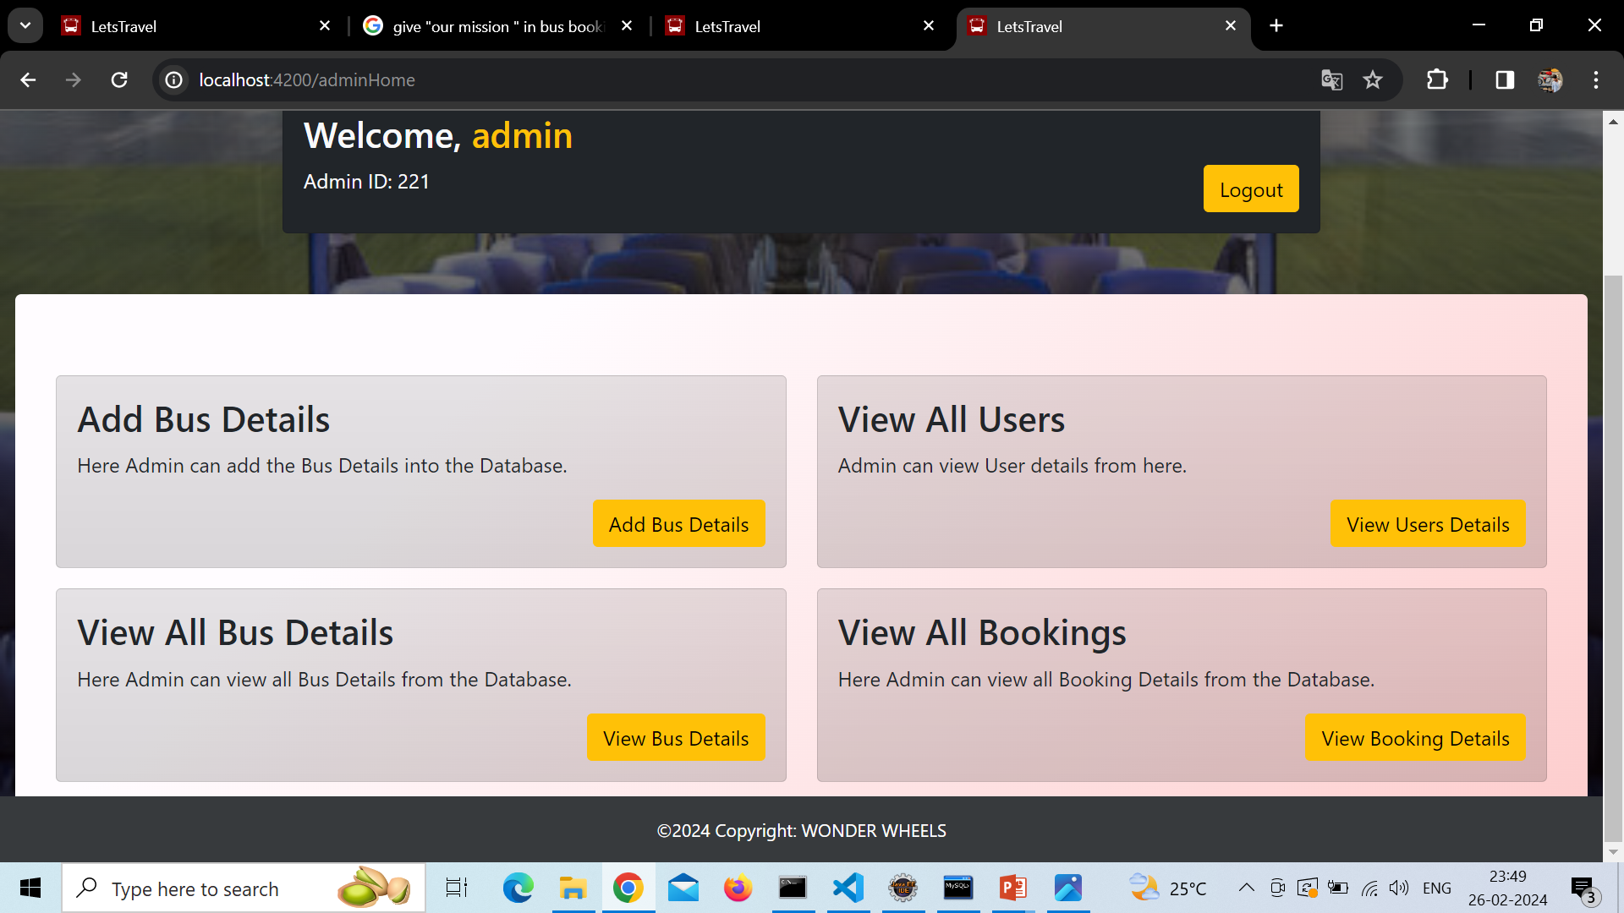
ADMIN HOME PAGE

Slide 42
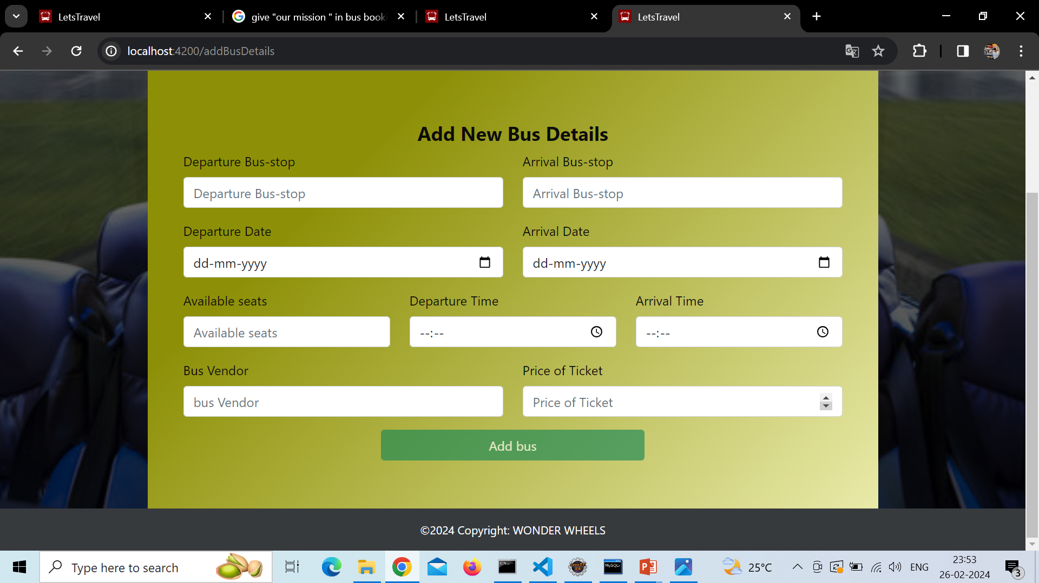
ADD NEW BUS DETAILS

Slide 43
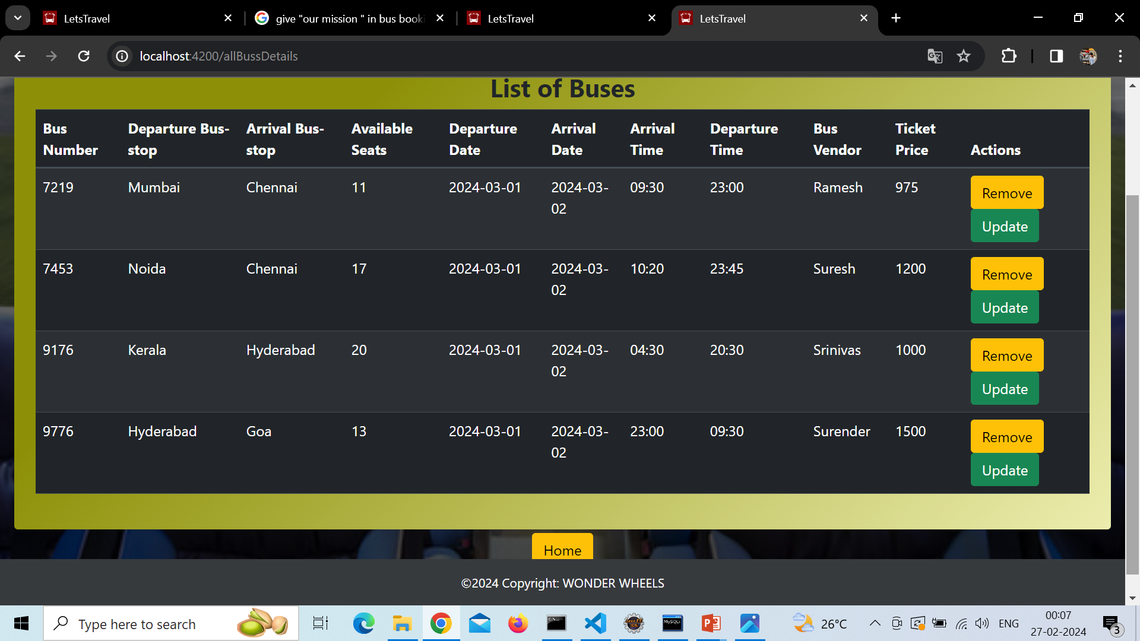
LIST OF BUSES

Slide 44
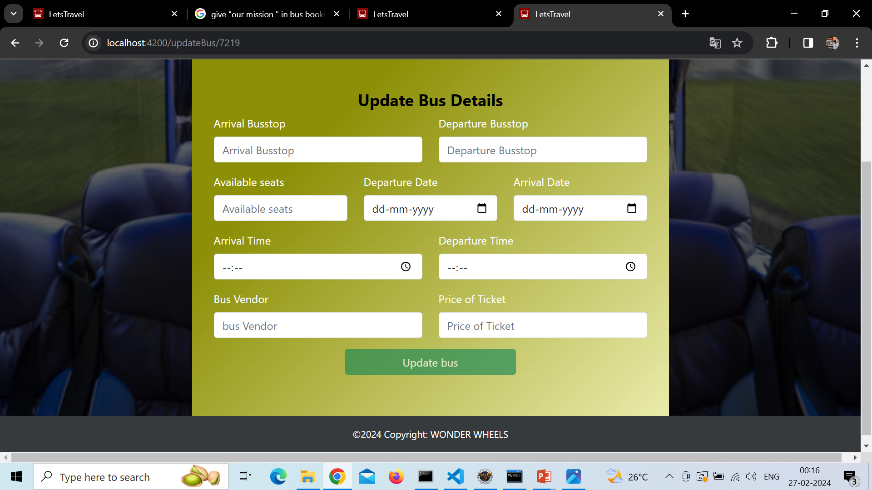
UPDATE BUS DETAILS

Slide 45
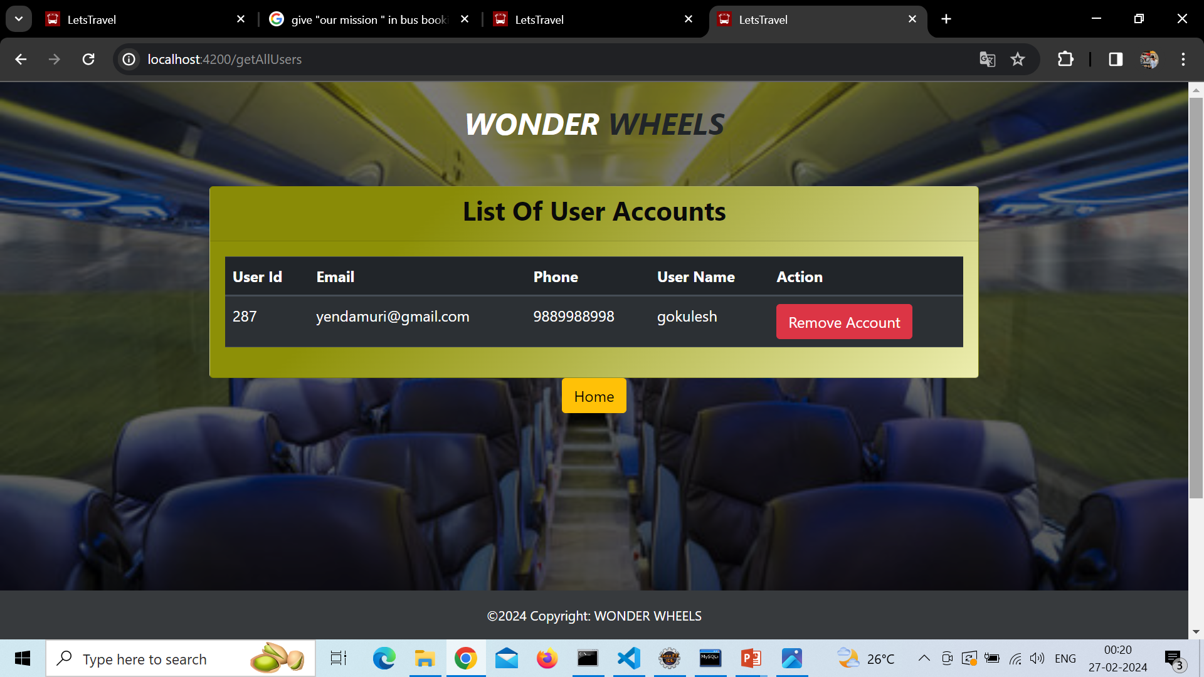
VIEW ALL USERS(ADMIN)

Slide 46
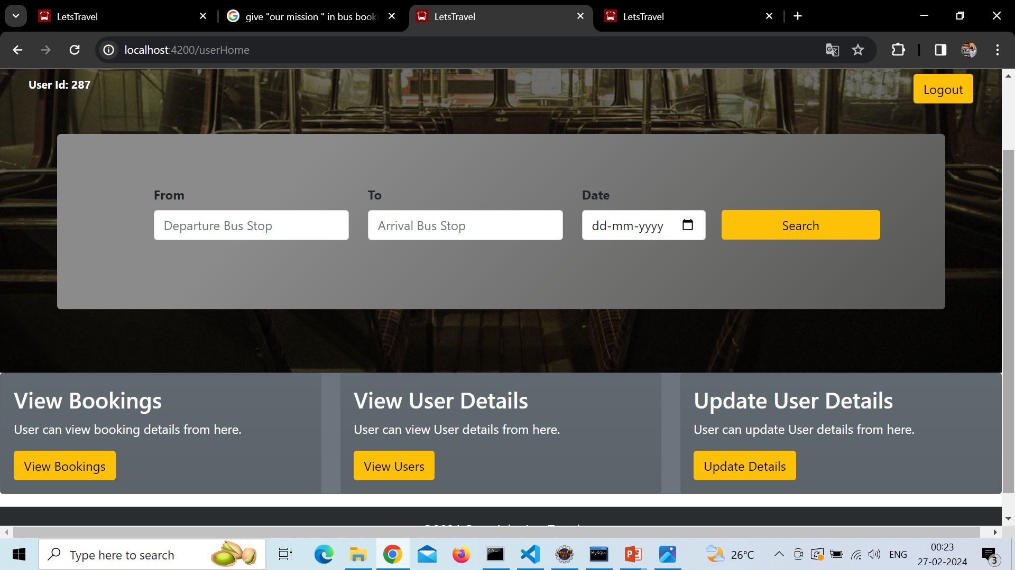
USER HOME PAGE

Slide 47
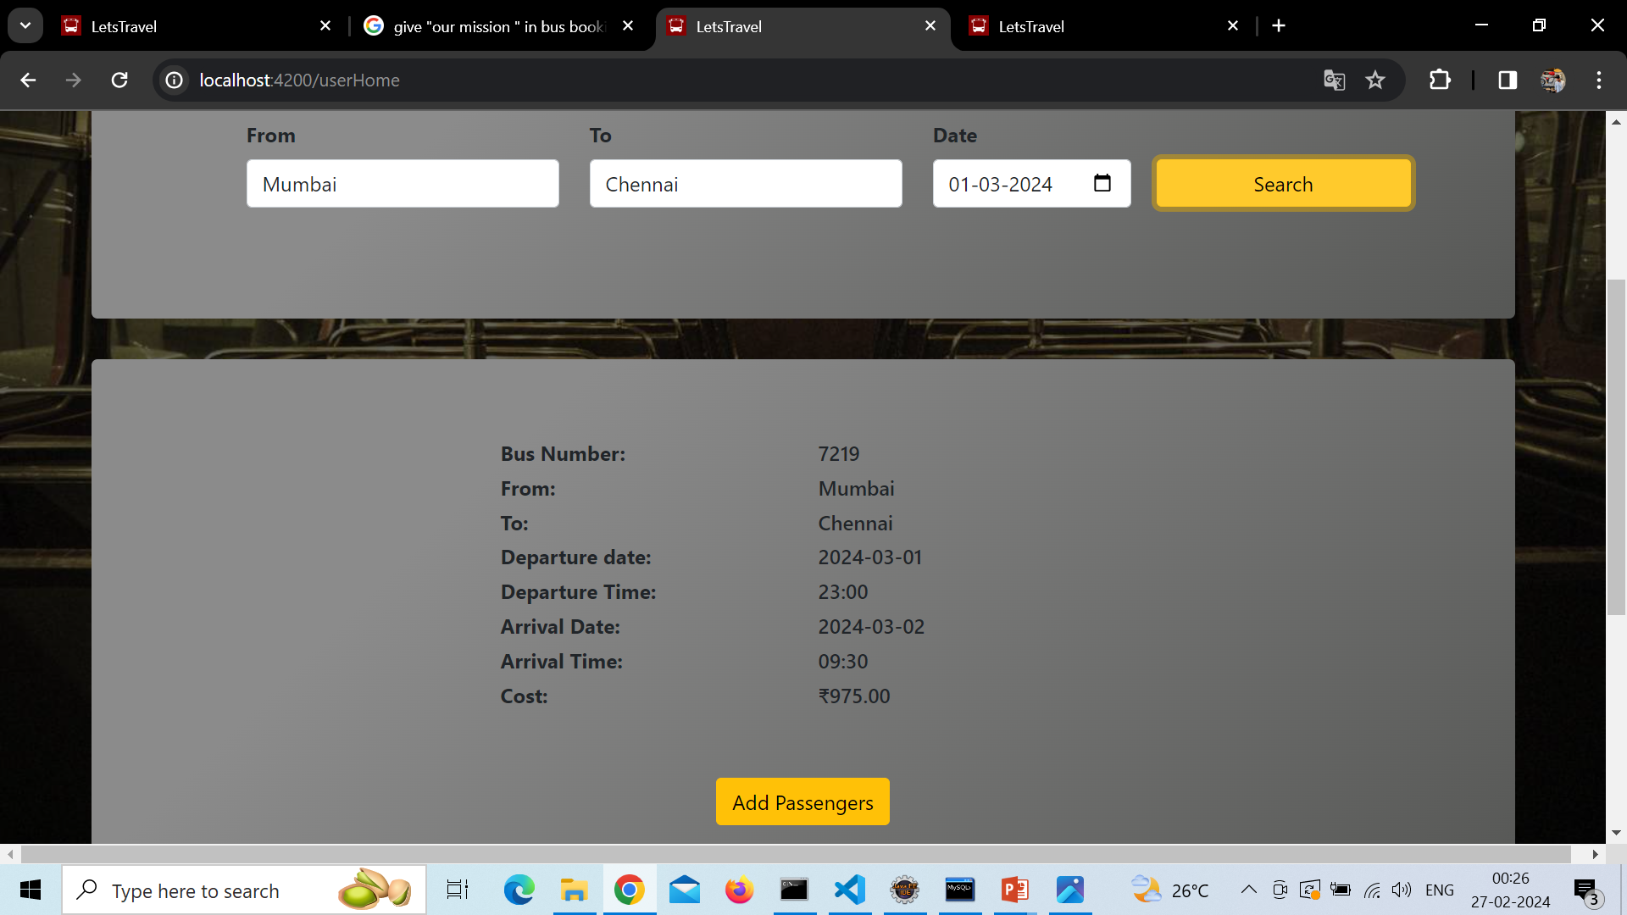
USER HOME PAGE(SEARCH)

Slide 48
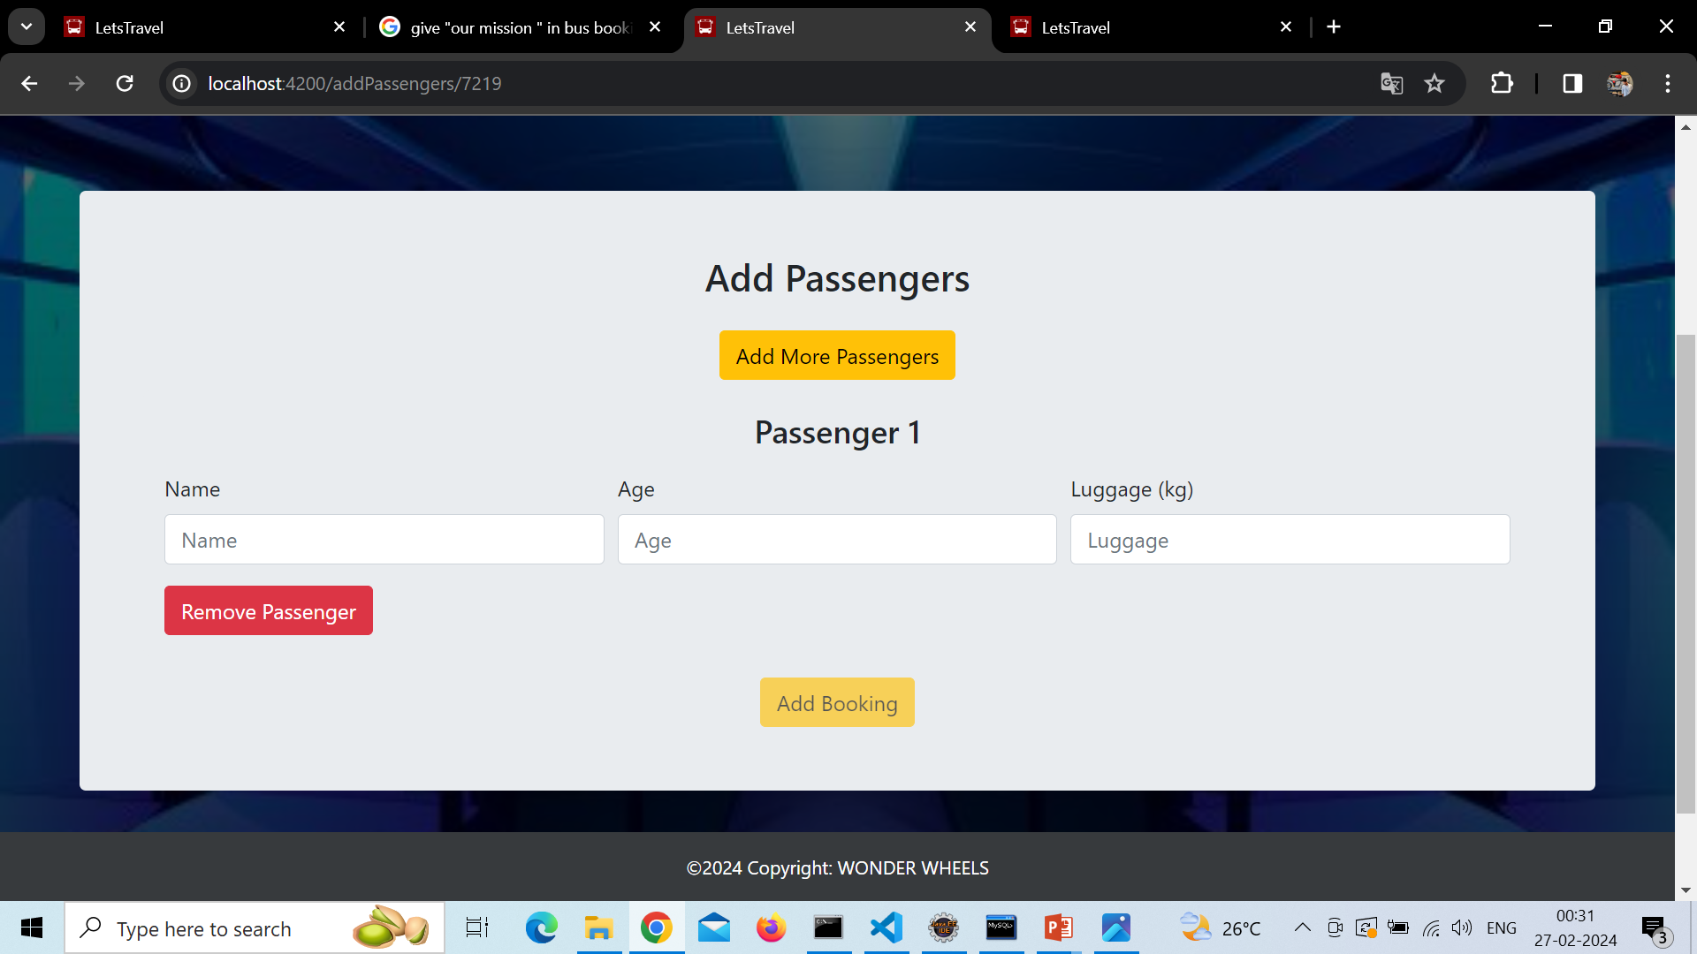
ADDING PASSENGERS

Slide 49
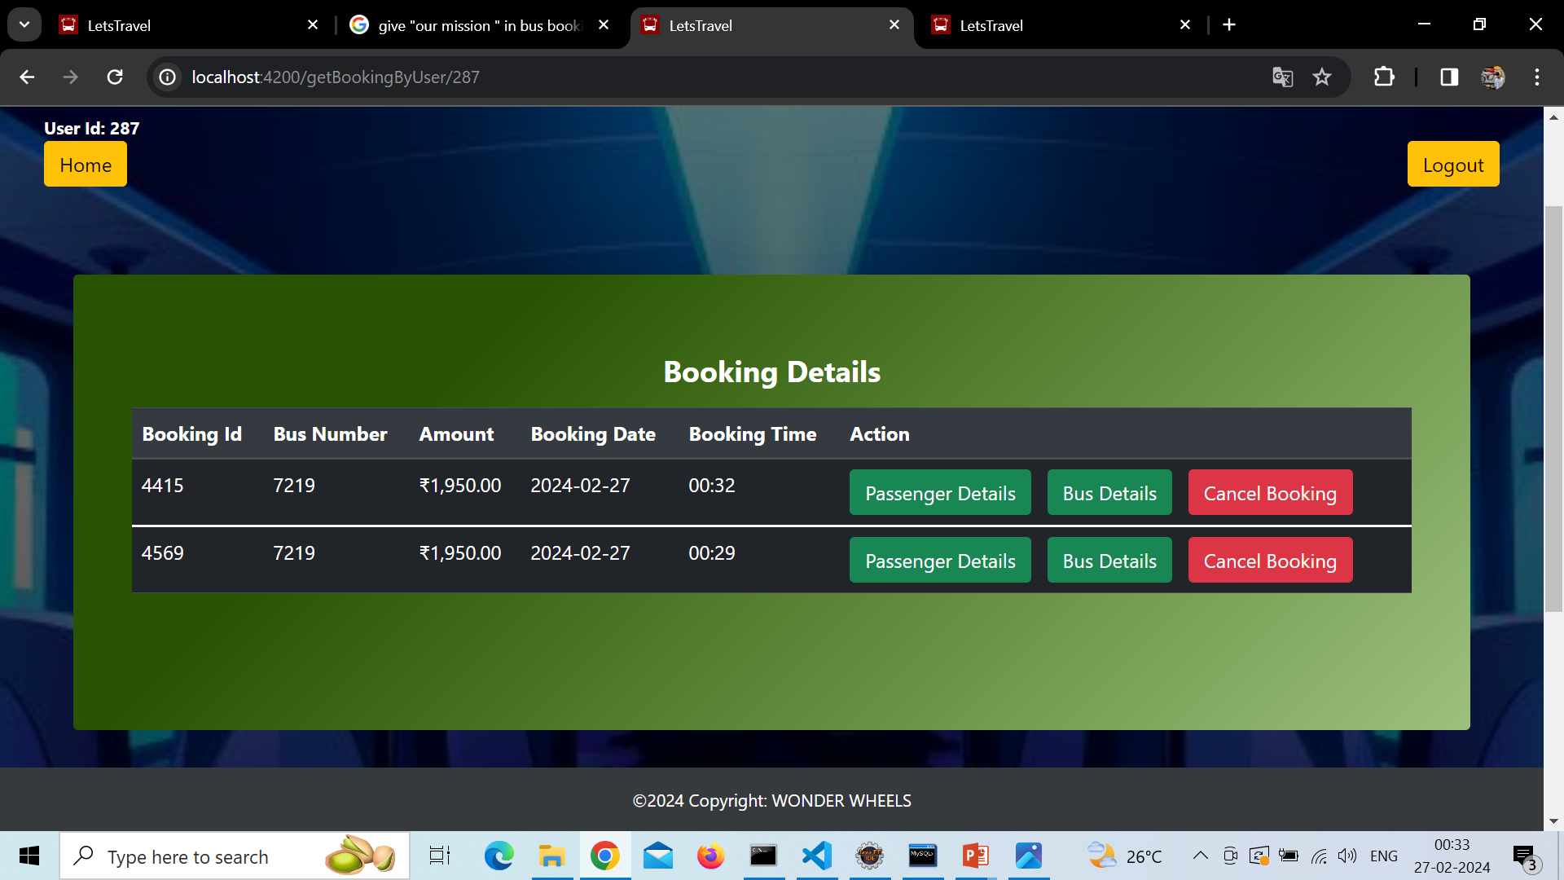
VIEW BOOKING BY USER

Slide 50
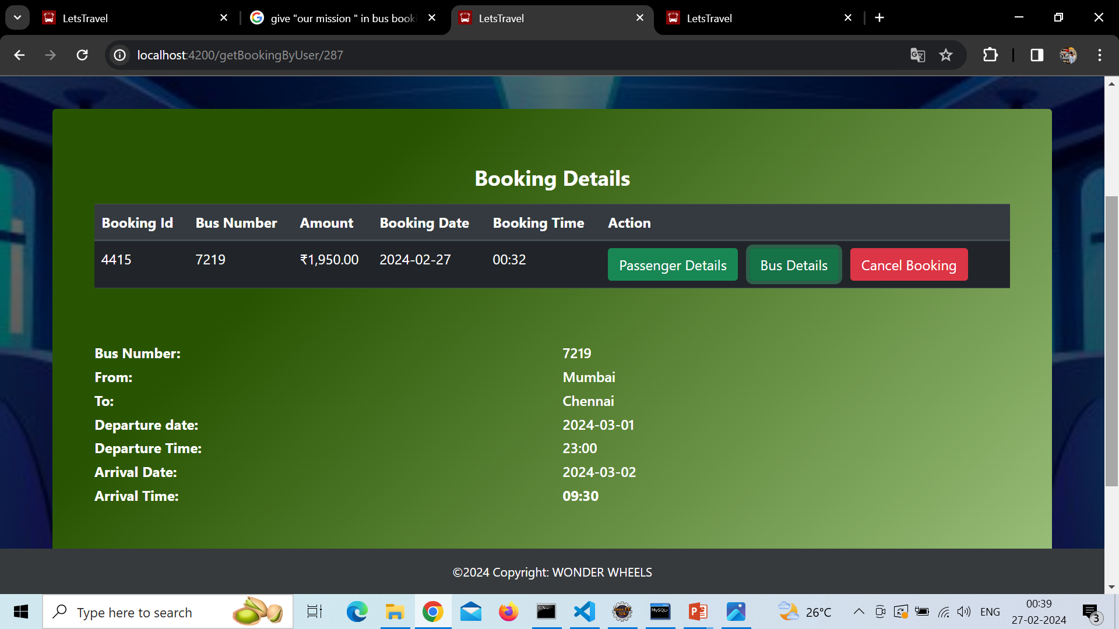
BUS DETAILS (IN BOOKING)

Slide 51
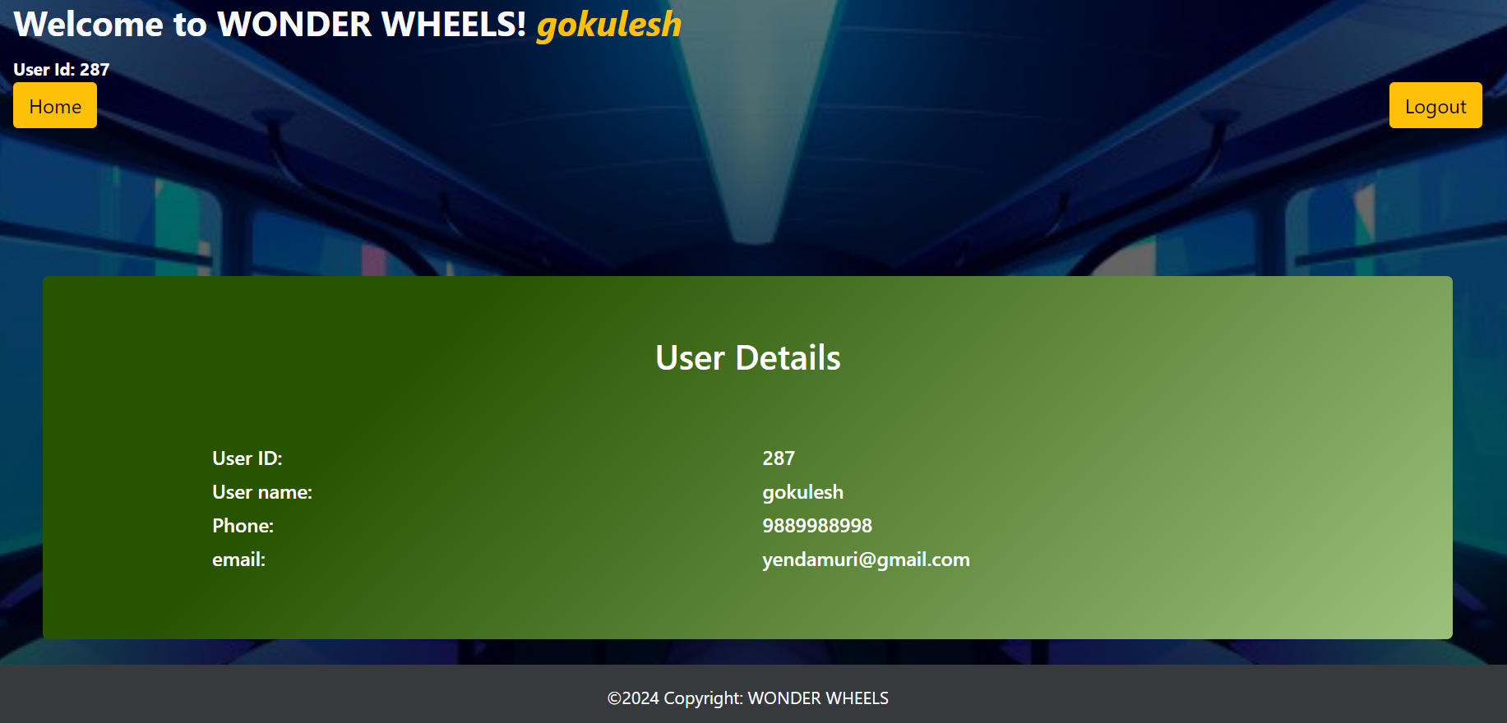
USER DETAILS

Slide 52
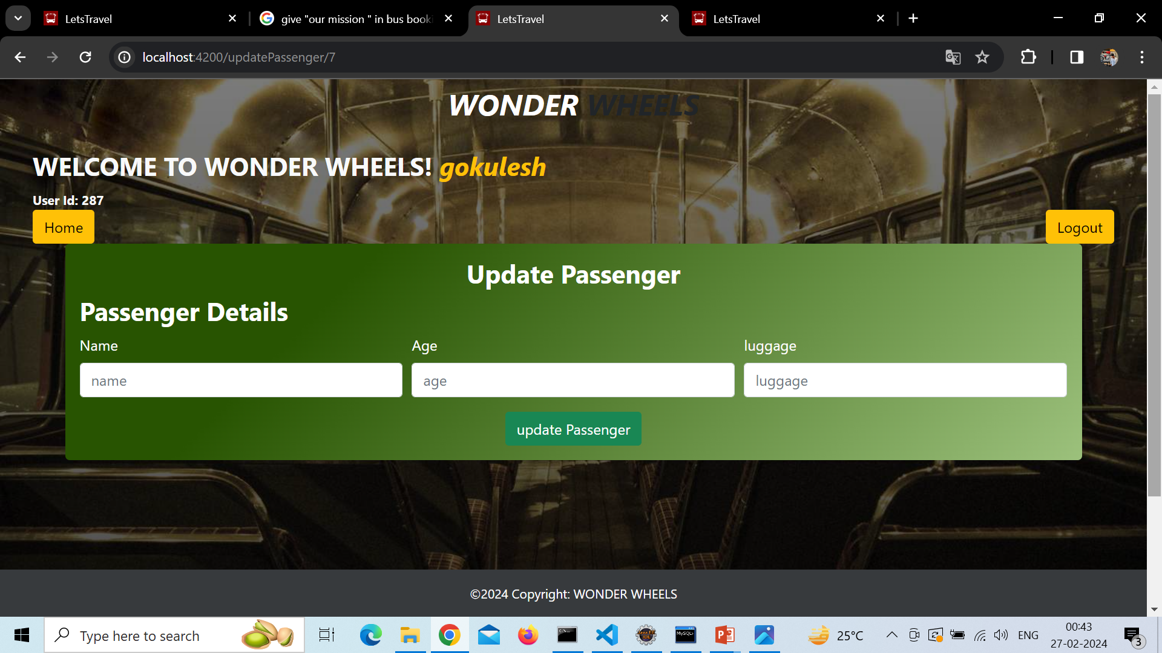
UPDATE PASSENGER DETAILS

Slide 53
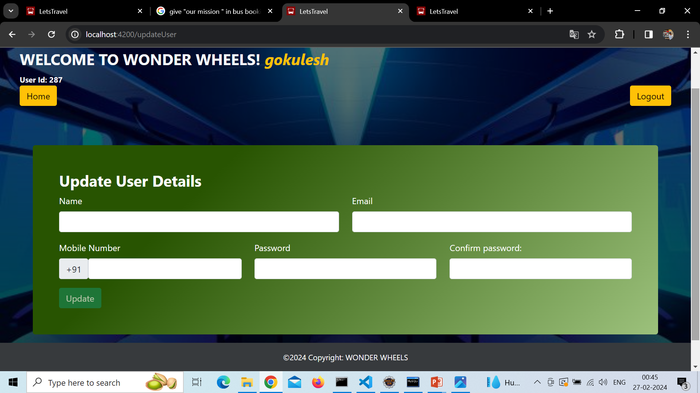
UPDATE USER DETAILS

Slide 54
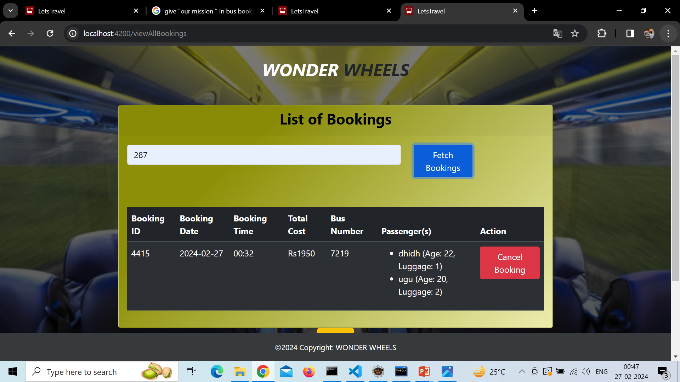
VIEW ALL BOOKINGS (ADMIN)

Slide 55
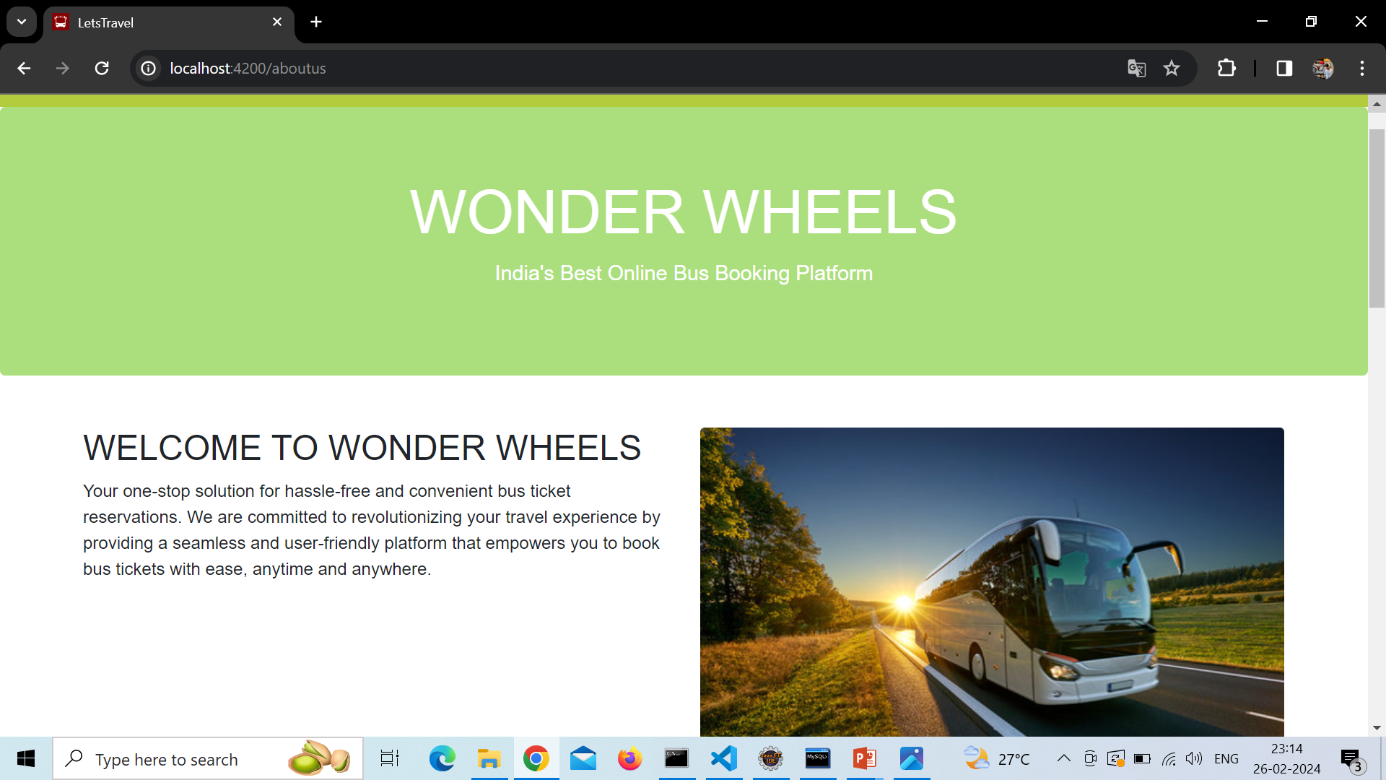
ABOUT US

Slide 56
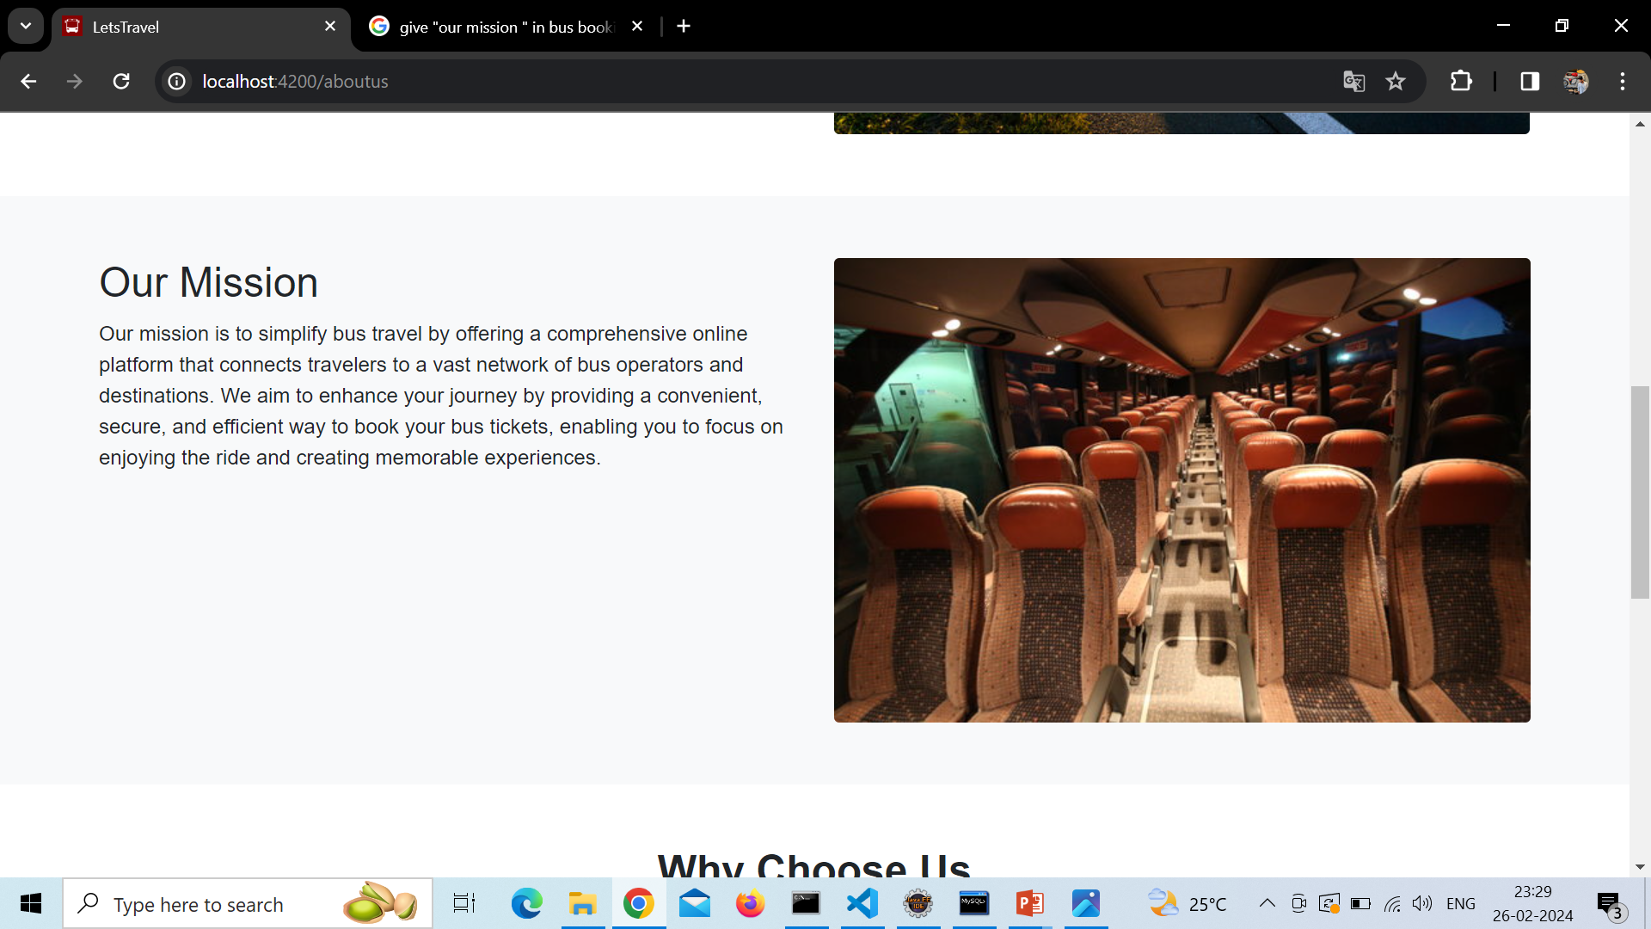
OUR MISSION

Slide 57
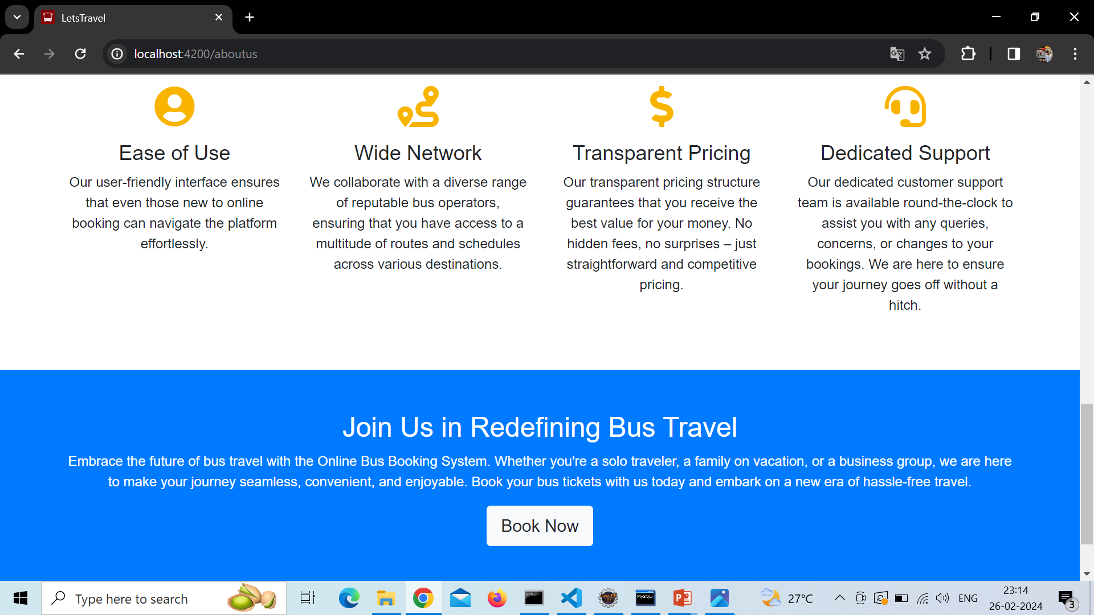

Slide 58
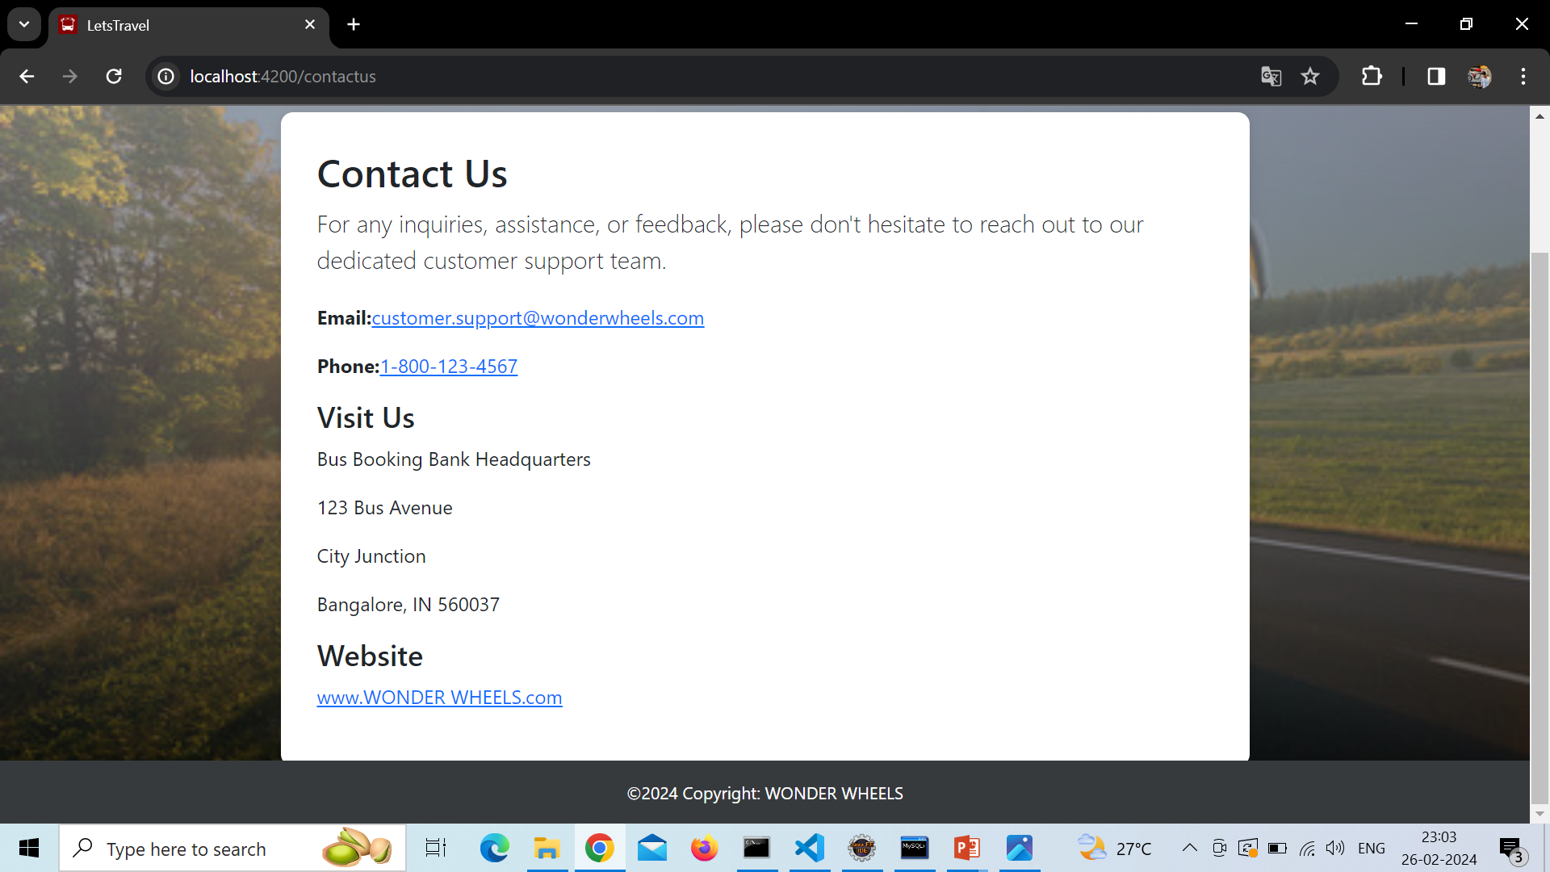
CONTACT US

Slide 59


